Slide 1
NFL Team Power Rankings
Parth Patel, Tre Bell, Tyler Piel, Landon Hill

Slide 2
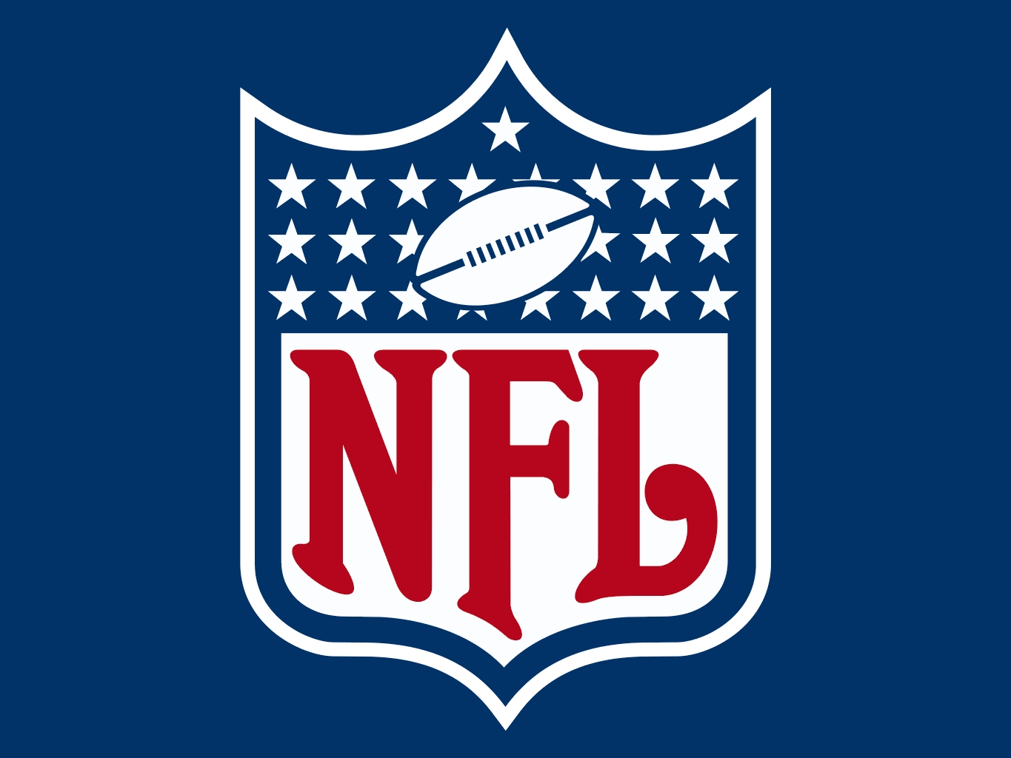
Background of NFL
NFL - National Football League
Founded in 1920 as the American Professional Football Association.
First nationally recognized professional football league
32 team franchises, separated into two conferences - AFC and NFC.
Each conference has 4 divisions based on location - North/East/South/West divisions
Each season spans from week 1 in September to the superbowl in February.
7 teams from each conference go to the playoffs in December, 4 teams who win their division and 3 wildcard spots.
Bracket system to determine best teams from each conference. Those teams face off in the Super Bowl.
Rankings and stats are kept recorded and analyzed by ESPN

Slide 3
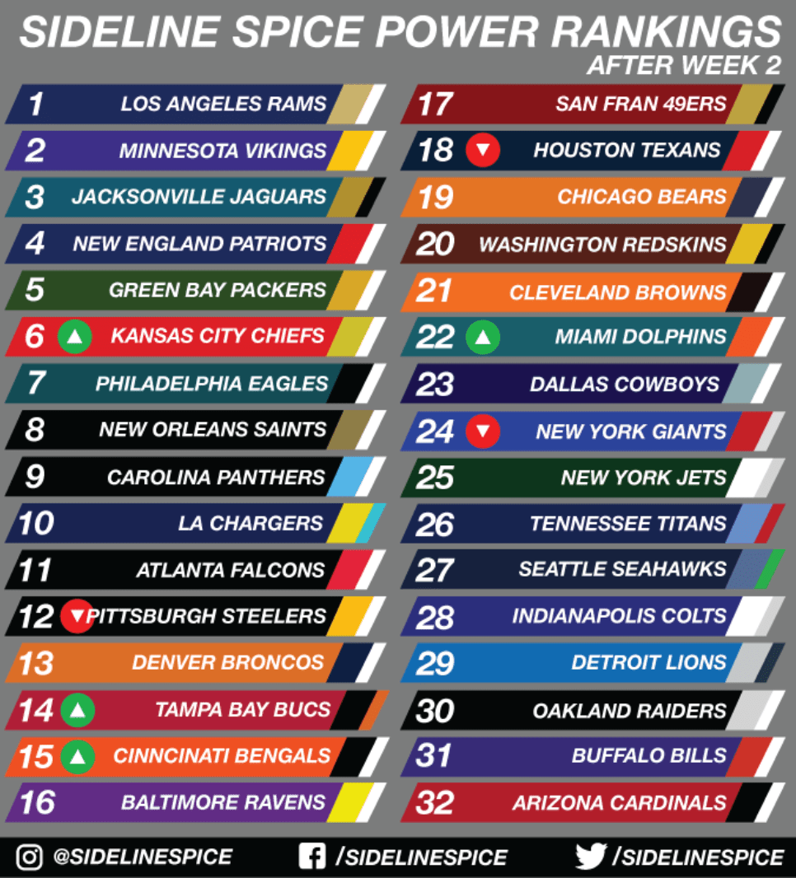
Objective
Create a machine learning model to accurately predict weekly NFL Power Rankings of each team.
Use weekly features such as total passing yards, rushing yards, turnovers, and defensive metrics to predict a team’s power rank.
Goal is to accurately predict a team’s power rank after a game is concluded and compare this with teamrankings.com power ranking list.

Slide 4
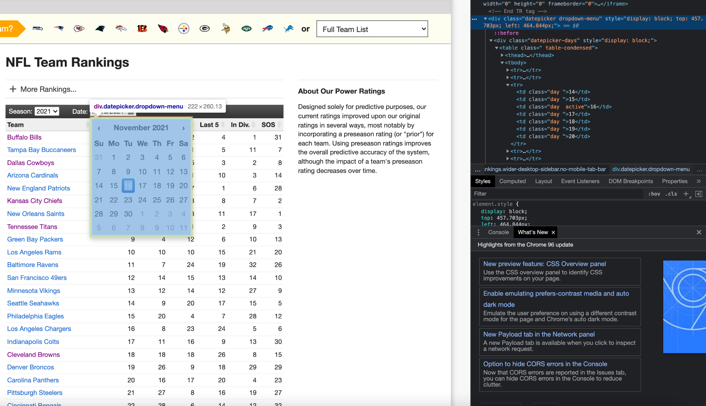
Acquiring the data
Our team used the selenium library in python to web scrape data from teamrankings.com.
This website provided us weekly stats on each team, such as passing yards, interceptions, total points scored per game, etc.
Data Formatting
Web scraping yielded a CSV file for each metric. These individual files were then formatted and then combined into a FinalData file
Issues: Data source issues, missing data issues, Team name changes, fault/corrupted data
24 features, 2003-2021,32 teams, 16 games, duplicated data

Slide 5
Generating a model
Supervised Learning Model
Trained out dataset with known features and labels (power ranking for that week)
Logistic regression provides a way to easily classify our teams based on multiple input features.
Specifically ordinal logistic regression model since labels are ordered in a meaningful way
Our mean-square-error (MSE) will be the difference in predicted rank versus actual power rank for each week
We can use a gradient to reduce our MSE and therefore improve the accuracy of our model.
We can standardize our data to work better with our regression model

Slide 6
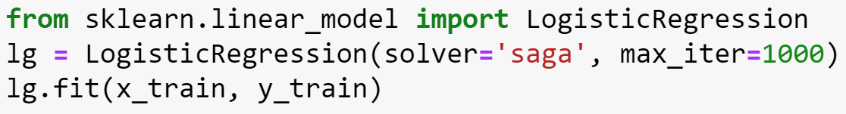
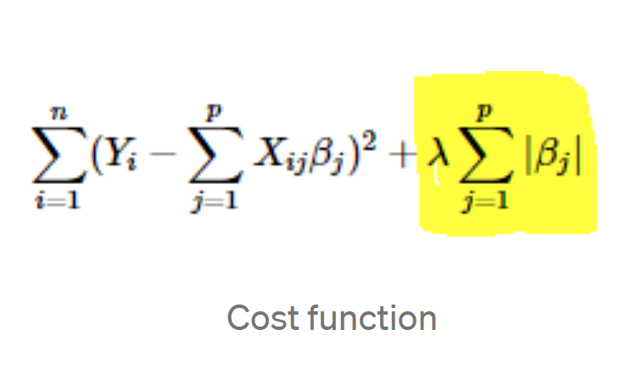
Finding a Regression method: the SAGA solver
Standardizing the data:
Zero mean, unit variance
Issue:
Large dataset, many features
Attempted Regressions
Gradient Descent
Stochastic Gradient Descent (SGD)
Stochastic Average Gradient (SAG)
Final Regression: SAGA Solver
Variant of SAG
Average gradient from random set of gradient selected in the data iteration
Allows L1 Regularization (Lasso Regression)
Higher penalty with cost function
Capably of dropping unimportant features to 0
Preferred for large datasets
Max number of iterations = 1000
Notes:
Attempted to use both full gradient descent and stochastic gradient descent
Full gradient descent utilizes the entire dataset per iteration, therefore can be costly for larger datasets.
Stochastic gradient descent uses one or more data points per iteration, therefore reducing the computational size per iteration.
Useful in our case since we have about 10,000 rows per feature, and about a dozen features.

Slide 7
Generating predictions and testing data
Training Results
Team Name | Actual Rank | Predicted rank
Kansas City Chiefs (9-13-20) | 2 | 1
Pittsburgh Steelers (9-20-20) | 11 | 10
Tennessee (9-20-20) | 14 | 12
Cleveland Brown (9-20-20) | 23 | 24
San francisco (9-20-20) | 4 | 4

Slide 8
Generating predictions and testing data cont.
Testing Results
Team Name | Actual Rank | Predicted Rank
Kansas City Chiefs (2021-10-03) | 2 | 3
Pittsburgh Steelers (2021-10-10) | 19 | 22
Tennessee Titans (2020-10-10) | 17 | 18
Cleveland Browns (2021-10-03) | 6 | 9
San Francisco 49ers (2021-10-31) | 16 | 24

Slide 9
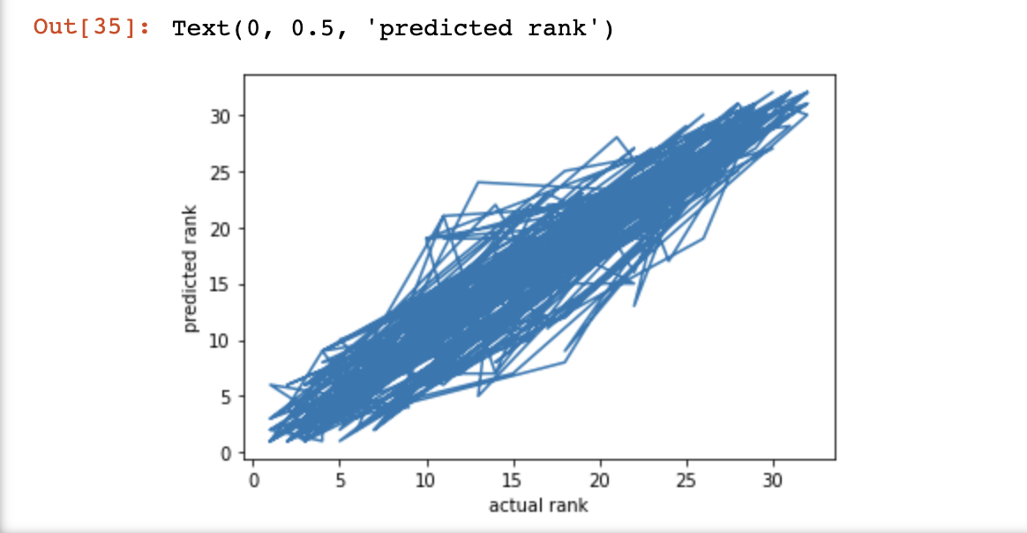
Results from logistic regression model
Positive correlation of predicted rank vs actual rank.
Using sklearn resulted in a higher accuracy (31%) than building our own gradient descent.

Slide 10
Issues we faced
Features we chose could overlap such as offensive yards per game vs. offensive yards per point.
Quality of web-scraped data.
Working with a large dataset made it more difficult to train the model and parse through bad data.
Uncertainty about what the best model to use for our data.
Used logistic regression model we chose had low accuracy for our data.
Different logistic regression options - binary logistic regression, multinomial logistic regression, ordinal logistic regression.

Slide 11
Conclusion and More
This model can be further improved to predict other features such as winner/loser each week or predict the final score by each team.
Other applications such as online betting or team pools to have the greatest odds at winning.
Potential Risks: Data can be biased or skewed depending on the method to parse the data.
For example, offensive metrics are a greater indicator of a team’s results but this wasn’t taken into account in our model.
Better quality and quantity input features.
I.e. ranking is done by humans and has a subjective element to it. So we would take the team name into account rather than go solely on the stats.
Take more stats into account. I.e. don’t repeat tasks.

